Slide 1


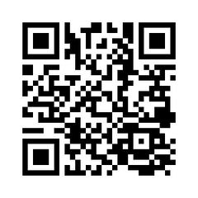


KW4 OHT
NEED A FAMILY DOCTOR OR NURSE PRACTITIONER?
Health Care Connect helps you find primary care close to home. Register today and get connected.
When you register, you can ask for a provider who speaks your language.
Register online at ontario.ca/healthcareconnect or call 8-1-1 — available anytime

